Slide 2
Prototyping Model
Advantages
Errors are detected much earlier.
Ensures a greater level of customer satisfaction and comfort.
It identifies the missing functionality easily.
It also identifies the confusing or difficult functions.
Disadvantages
The client involvement is more and it is not always considered by the developer.
It is a slow process because it takes more time for development.
Many changes can disturb the rhythm of the development team.

Slide 3
Spiral Model
Barry Boehm.B introduced Sprial Model in 1986.
Spiral model is one of the most important Software Development Life Cycle model, which provides support for risk handling.
The Spiral Model is a risk-driven evolutionary process model in which software is developed through repeated iterations, and risk analysis is performed in every cycle.
In its diagrammatic representation, it looks like a spiral with many loops.
Each loop of the spiral is called a phase of the software development process.
This model is much more flexible compared to other SDLC models.

Slide 4
Prototype Focus
Problem
Requirements are unclear
Build Prototype
Customer Gives Feedback
Requirements Become Clear
Develop Final Software
Prototype answers one question:
"What exactly does the customer want?"

Slide 5
Spiral Model
Barry Boehm.B introduced Sprial Model in 1986.
Spiral model is one of the most important Software Development Life Cycle model, which provides support for risk handling.
In its diagrammatic representation, it looks like a spiral with many loops.
Each loop of the spiral is called a phase of the software development process.
This model is much more flexible compared to other SDLC models.

Slide 6
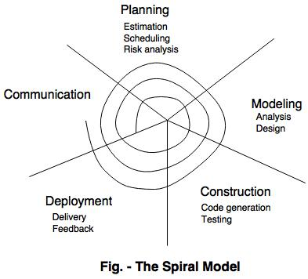

Slide 7
Spiral Focus
Problem
High Risk
Identify Risk
Reduce Risk
Develop Software
REPEAT
Prototype answers one question:
"What can go wrong, and how do we prevent it?“
"Developer, what risks may affect this project?"

Slide 8
Types of Risk in Spiral
1. Technical Risk
Meaning
Technology may fail.
Example
Your company decides to use AI-based Face Recognitionfor banking login.
Question
Will it work perfectly?
Nobody knows.
Maybe Recognition is slow.
Wrong person gets authenticated.
Camera doesn't work.
This uncertainty is called
Technical Risk.

Slide 9
2. Cost Risk
Example
Estimated Budget
₹10 Crores.
After six months,
Need more servers.
Need more developers.
Budget becomes
₹16 Crores.
Company loses money.
This is
Cost Risk.

Slide 10
3. Schedule Risk
Example
Software should finish in 12 months.
But
Developers resign.
Requirements change.
Testing takes longer.
Project finishes in
18 months.
Customer becomes unhappy.
This is
Schedule Risk.

Slide 11
4. Requirement Risk
Prototype
Requirements are NOT KNOWN.
Requirement Risk
Requirements are known BUT Customer may still change them.
Example
Initially Customer wants Password Login.
Later
Customer wants Face Recognition.
Requirement changed.
This is Requirement Risk.

Slide 12
5. Security Risk
Example
Internet Banking.
Questions
Can hackers steal money?
Can hackers access passwords?
Can database leak?
These are
Security Risks.

Slide 13
Definition from Pressman
An evolutionary process model that couples the iterative nature of prototyping with the controlled and systematic aspects of the waterfall model and adds risk analysis as its central activity.
Waterfall + Prototyping + Risk Analysis = SpiralModel

Slide 14
Spiral Model
    Communication – Gather Requirements from Customers
    Planning – Plan to be followed will be created. It describes the technical task to be conducted, risk ,required resources, work schedule etc.,
    Modeling – A model will be created to better understand the requirements
    Construction – Code generated and tested
    Deployment - Complete or partial complete version of software is given to the customer to evaluate and they give feed back based on the evaluation

Slide 15
Spiral Model
Advantages:
It reduces high amount of risk.
It is good for large and critical projects.
It gives strong approval and documentation control.
In spiral model, the software is produced early in the life cycle process.
Disadvantages:
It can be costly to develop a software model.
It is not used for small projects.

Slide 16
Example: Online Banking System
Loop 1
Develop:
Login Module
Risk:
Password Security
Loop 2
Develop:
Money Transfer
Risk:
Transaction Failure
Loop 3
Develop:
Bill Payment
Risk:
Fraud Detection
Loop 4
Develop:
Complete Banking System
Risk:
Performance with millions of users

Slide 17
Advantages
1. Risk is identified early.
2. Suitable for large and complex projects.
3. Customer involvement is high.
4. Changes can be incorporated easily.
5. Better quality software.
6. Continuous improvement.

Slide 18
Disadvantages
1. Expensive.
2. Requires experienced developers.
3. Risk analysis is difficult.
4. Not suitable for small projects.
5. Management becomes complex

Slide 19
Concurrent Development Model
The concurrent development model is called as concurrent model.
The communication activity has completed in the first iteration and exits in the awaiting changes state.
The modeling activity completed its initial communication and then go to the underdevelopment state.
If the customer specifies the change in the requirement, then the modeling activity moves from the under development state into the awaiting change state.
The concurrent process model activities moving from one state to another state.

Slide 20
Concurrent Development Model
The Concurrent Development Model is an evolutionary process model in which different software development activities happen simultaneously (concurrently) rather than one after another.
It was introduced because real software projects do not follow a strict sequence like:
Requirements
↓
Design
↓
Coding
↓
Testing
↓
Deployment
In real projects, many activities happen at the same time.

Slide 21
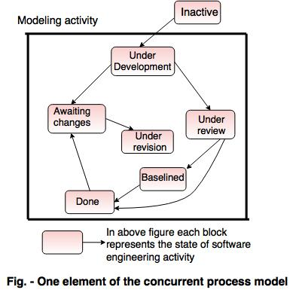
Concurrent Development Model

Slide 22
Advantages of the concurrent development model
This model is applicable to all types of software development processes.
It is easy for understanding and use.
It gives immediate feedback from testing.
It provides an accurate picture of the current state of a project.
Disadvantages of the concurrent development model
It needs better communication between the team members. This may not be achieved all the time.
It requires to remember the status of the different activities.

